Slide 1

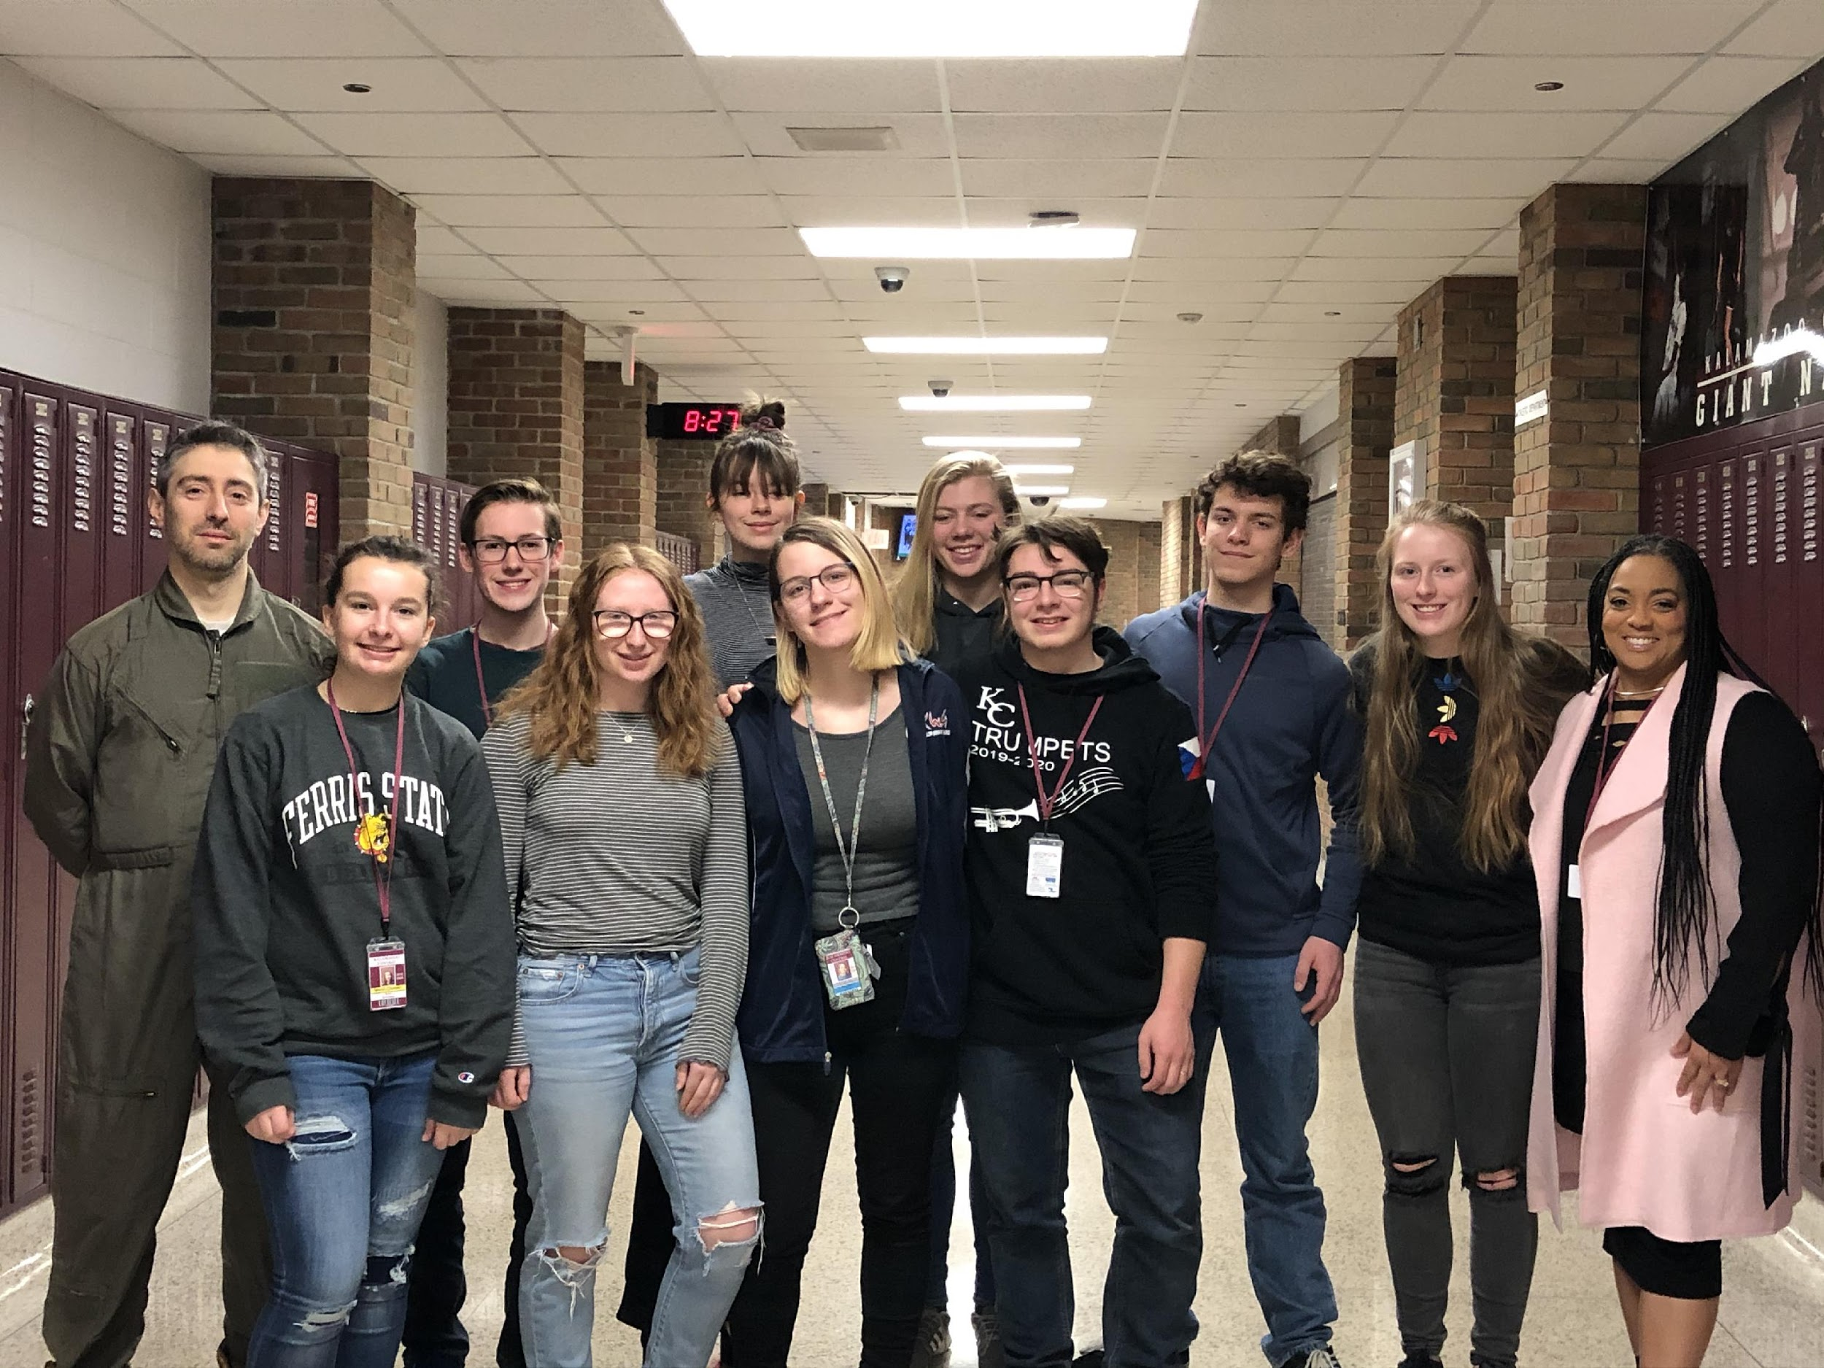
Air and Climate Challenge
Kalamazoo Central Climate Advocates
Kalamazoo Central High School in Kalamazoo, Michigan
Nora Schwartz, Owen Hoover, Natalie Gross, Chloe Carlson, Maggie Lekan, Kendal VanDam, Kevin Wesel, Miles Lekan, Kearney Miller
Advisor: Josh Gottlieb
Principal: Valerie Boggan
1
Notes:
1

Slide 2

What’s the environmental issue?
We are turning Kalamazoo Public Schools into a
“Green District”.
Climate change is an existential crisis. The UN IPCC warns of disastrous consequences if we do not fundamentally change the way we live on this planet. So it falls to each of us to decide what we can do to be part of the solution rather than part of the problem. We find allies. We build coalitions to amplify our actions and voices. We then ask the question, “Given our unique situation and sphere of influence, how can we maximize our impact?”
2
Notes:
2

Slide 3
What’s the environmental issue? (continued)
We, the Kalamazoo Central High School Climate Advocates, are committed to achieving concrete, quantifiable successes in fighting climate change. It is often difficult to evaluate efficacy. In a different type of war (and we are at war), one might count up the number of enemies killed or the acreage of land taken. But this is a war in which the enemy is more abstract, harder to kill or capture or pin down.
If you write your congressperson advocating for a price on carbon (as we have done), were you successful? It’s hard to know. Even if HR763 ultimately passes, it likely would have passed anyway without your few letters. Did you help? If you attend rallies (as we have done), were you successful? Can you quantify the decibel level and isolate the contribution of your cry? Furthermore, can you do the calculus to determine the impact of your voice on CO₂ equivalent reductions?
We chose to turn Kalamazoo Public Schools into a “Green District” because we are scientists, and we have concluded that this will be the most directly impactful action that we can take. We will be able to calculate our precise contribution to the cause of survival in the form of tons of CO₂ withheld from the atmosphere. We will be able to point to the numbers and say, “We did that!”
3
Notes:
3

Slide 4
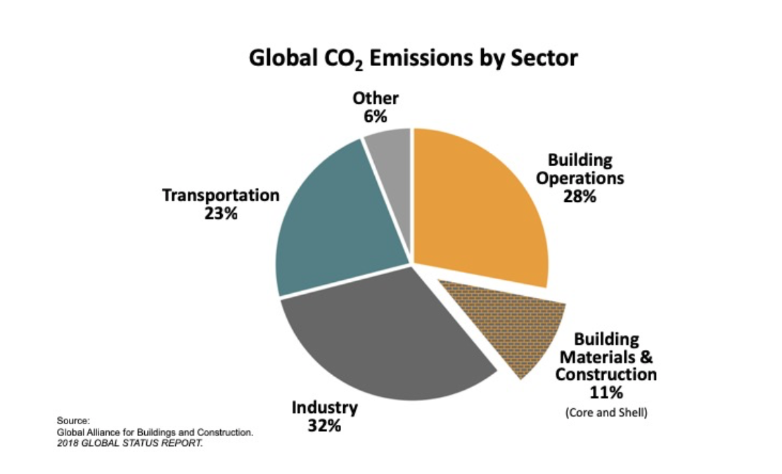
What’s your action plan?
Kalamazoo Public Schools is an urban district that educates roughly 13,000 students across 26 buildings. Although we as a community take pride in our district, the facilities, and the extraordinary efforts taken to serve the students of the district, many of the buildings are quite old and much of the capital infrastructure is out of date. As you can see in the figure, building construction and operations, when examined together, are the largest contributor to global CO2 emissions. We will reduce the carbon footprint of the district by 30% over 10 years by retrofitting our existing buildings with modern, efficient technologies that address issues of heating and cooling, lighting, insulation, energy use and production, and water usage among others.
4
Notes:
4

Slide 5
What’s your action plan? (continued)
We are using a multi-tiered approach:
PHASE 1
The first step in the scientific method is to clearly state the problem. Because our goal for the district cannot be accomplished by a small group of students alone, we must begin by educating the adults and helping them formulate the problem for themselves. To that end, we have done the following:
Over the past summer, we partnered with other local organizations including Western Michigan University Office of Sustainability and Climate Change Working Group, K College, KVCC, Citizens’ Climate Lobby, Sierra Club, and Extinction Rebellion to form the Kalamazoo Climate Crisis Coalition.
We lobbied the city of Kalamazoo to declare a climate emergency, which they did on October 21 of this year.
We became the first school in Michigan to pass a resolution declaring a climate emergency on November 5 of this year.
We have presented to several other schools around the district. We mentored younger students as they to crafted their own resolutions of climate emergency.
...and we have plans to do the following:
We will approach the Board of Education as a coalition and work with the district to craft its own declaration of climate emergency. Once we are all on the same page that climate change is an existential emergency that justifies capital investments, we will be able to proceed to implement the recommendations of this group.
5
Notes:
5

Slide 6
What’s your action plan? (continued)
PHASE 2
We have formed a partnership between Kalamazoo Public Schools, Consumers Energy, and the US Green Building Council.
Consumers Energy has agreed to benchmark each building in the district. Thus far, they have completed the benchmarking of the high schools.
Once the benchmarking is complete, we will be provided with detailed data about energy usage, sources of waste, areas for improvement, etc for each site in the district. We have received our data for Kalamazoo Central High School.
At that point, the US Green Building Council – West Michigan Chapter and Consumers Energy will bring in experts to mentor students as the students formulate recommendations to the Board of Education. The students will present their initial recommendations to district administration on March 25, 2020.
*Note: We will be able to make the ethical case based on the declaration of climate emergency that the Board will have already made; however, we will not rely on that. We will make the business case to the Board of Education that implementation of our recommendations will save the district money in the long run. Purely in terms of the financial return on investment, our recommendations will be justified.
There are no moral victories when it comes to survival. Because we cannot count how many human lives we will save, we will use the proxy of CO2 equivalent reductions in emissions.
We will have benchmark data for each building’s energy usage. We will be able to compare that to data gathered in subsequent years for each site. We will look at the total energy saved and convert that to the amount of CO₂ that we have saved from entering the atmosphere.
6
Notes:
6

Slide 7
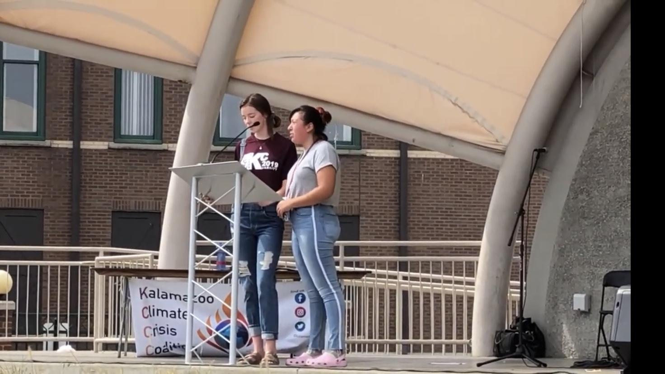
Implementation: How did you implement your ideas?
We started coalition building this past summer. We were founding members of the Kalamazoo Climate Crisis Coalition along with WMU, K College, KVCC, Citizens’ Climate Lobby, Sierra Club, and Extinction Rebellion. Chloe Carlson represented our group on the steering committee that planned a major rally for the September 20, 2019 Day of Global Action on Climate Change in which many of our members gave impassioned speeches to thousands of people in downtown Kalamazoo. (https://www.youtube.com/watch?v=yepU_BX5skA) (https://www.youtube.com/watch?v=GjHWwn0INVU&t=20s)
We also participated in planning a year-long series of Friday community events, many of which we are hosting at Kalamazoo Central HS, in support of Greta Thunberg’s Fridays For Future movement.
We met with our principal, Mrs. Valerie Boggan, and elicited her support. We produced a Climate Change Video and had every teacher in the building play the video during 2nd period on a given day, so every student would see it and have the opportunity to discuss.
https://www.youtube.com/watch?v=51Kl58Z5MpE&t=0s
7
Notes:
7

Slide 8
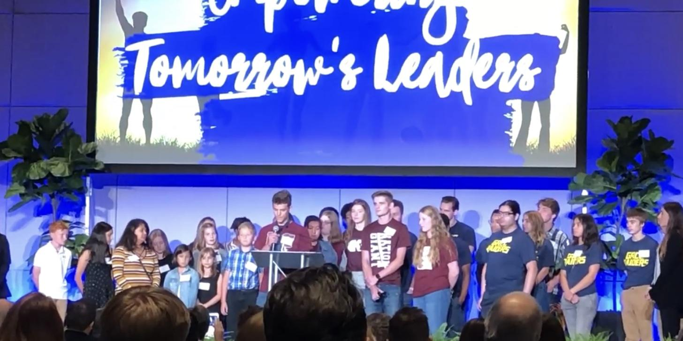

Implementation: How did you implement your ideas? (continued)
Through our networking and many partnerships, we were invited to present at the Drawdown MI Conference in Grand Rapids, MI. It was there that we initially met Cheri Holman, Executive Director of US Green Building Council – West Michigan and Marty Morgan, Senior Engineer with Consumers Energy.
https://www.youtube.com/watch?v=ozQQieTXQQY&t=0s
We enlisted the support of both the US Green Building Council and Consumers Energy to act as consultants for our project. They both agreed almost immediately, as our mission overlapped very closely with their own.
8
Notes:
8

Slide 9
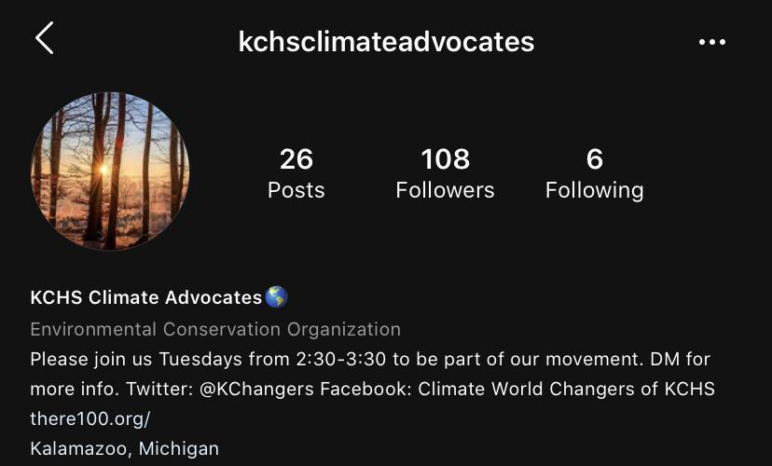
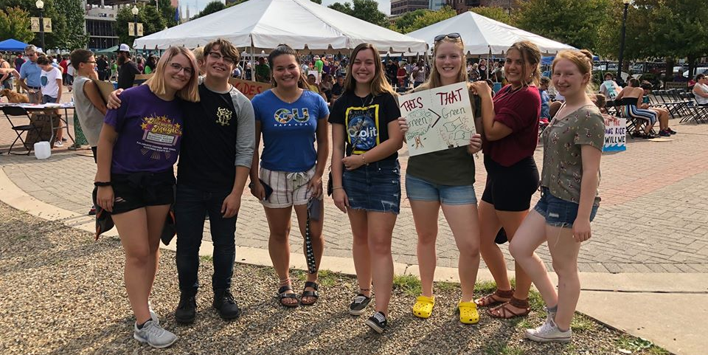
Implementation: How did you implement your ideas? (continued)
We organized an event at Kalamazoo Central HS on October 18 focused on “Empowering Youth to Act.” With our partners from USGBC and Consumers Energy, we made the formal announcement to the district and laid out our plans to “green the district.”
Now we are spreading the word. We are taking advantage of:
social media (https://www.instagram.com/kchsclimateadvocates/)(https://twitter.com/KChangers) (https://www.facebook.com/CWCKCHS/)
news stories (https://www.wmuk.org/post/greta-thunbergs-climate-movement-comes-kalamazoo-central) (https://wwmt.com/news/local/kalamazoo-students-preparing-for-climate-walkout-say-sustainability-is-vital)
and community events (https://wmich.edu/climatechange/kalamazoo-climate-crisis-coalition) (https://www.facebook.com/kalamazoocrisis/)
9
Notes:
9

Slide 10
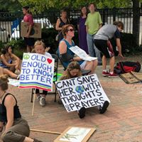
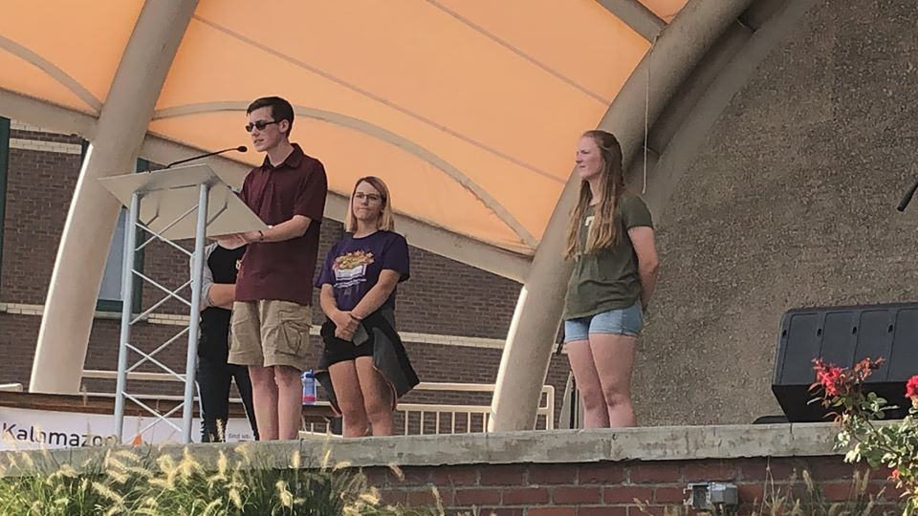
Results: Evaluate your plan. What are the results?
Change is hard. Progress can feel slow. But every once in a while, a thousand seemingly unrelated forces come together to effect change. We are at a tipping point, a point of inflection at which we will either change or we will seal our fate and the fate of all future generations.
Our group came together just 6 months ago, a small group of high school students and an advisor, wondering what we could possibly do about climate change. In that short time, we feel we have made great progress and met with much success.
10
Notes:
10

Slide 11
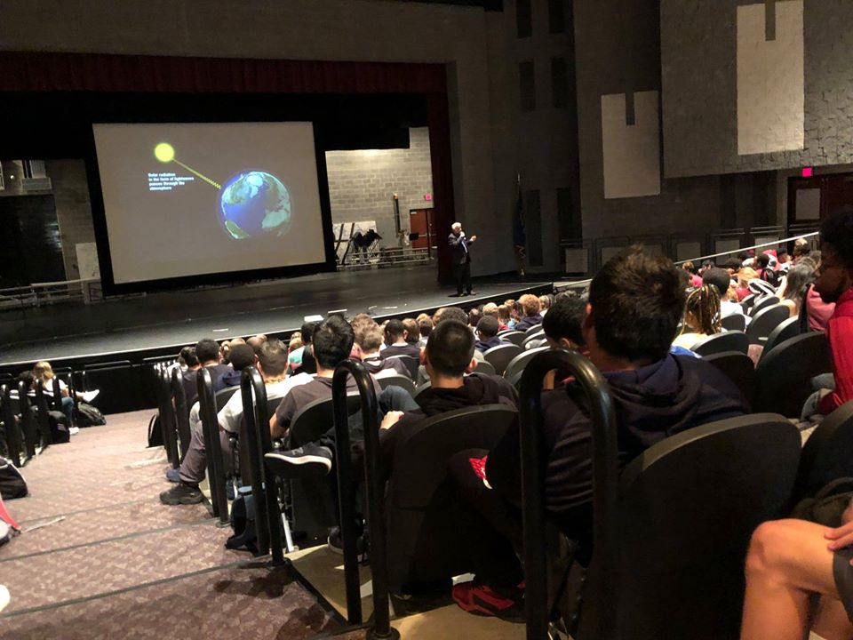
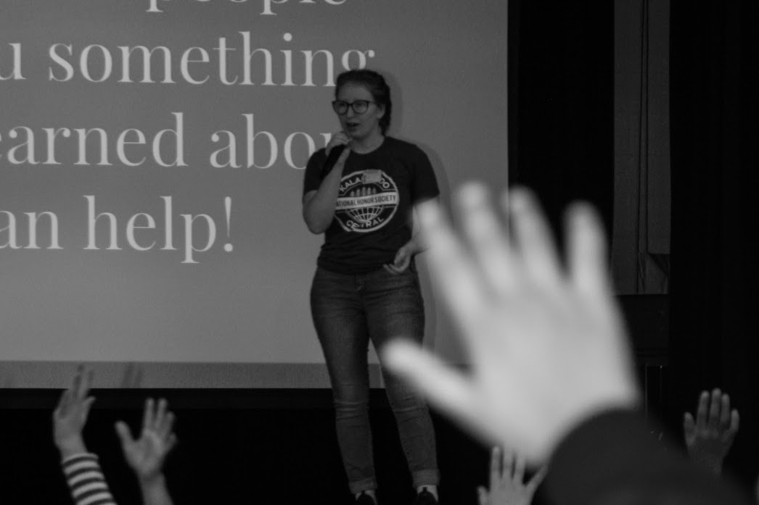
Results: Evaluate your plan. What are the results? (continued)
We have developed many partnerships with others in the community who feel strongly about climate issues. We have cemented our reputation, not just as students, but as mature advocates and active citizens in our community and beyond. We have raised awareness in our school through morning announcements, videos, and the hosting of four different major community events held in our auditorium in just the first trimester of the school year. We have educated others in our community and beyond by presenting at conferences, visiting schools, and speaking at rallies.
11
Notes:
11

Slide 12
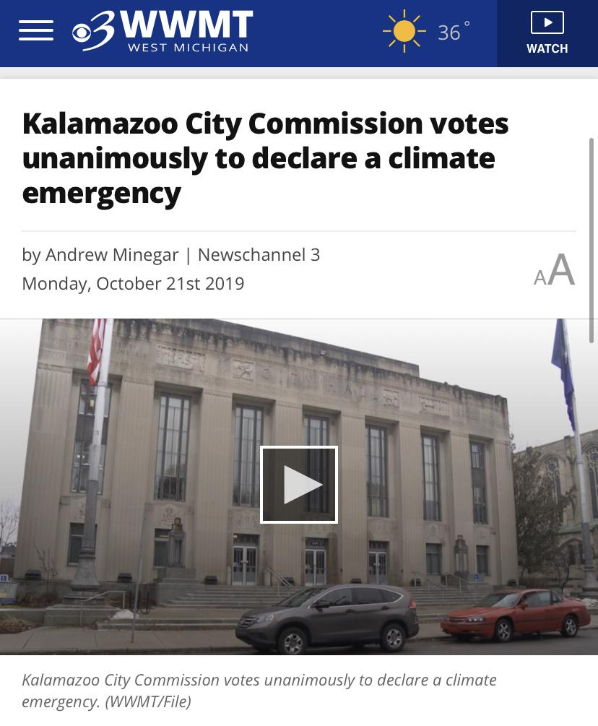
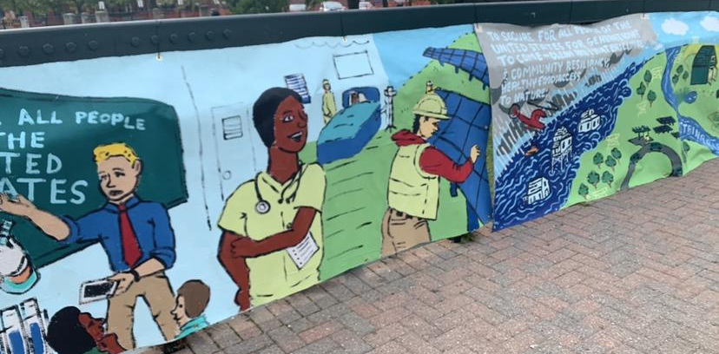
Results: Evaluate your plan. What are the results? (continued)
We have received energy data for the high schools. Our current Energy Star Score is 60 out of 100, and the other high school in the district is 40 out of 100. (Lower score is better like golf.) That shows we have lots of potential for improvement! We are currently formulating our recommendations for the district. For this first round of funding, we are focusing on lighting as the lowest hanging fruit. We have thousands of fixtures that need to be updated to LEDs in our building alone. We are also proposing installation of solar panels on several buildings in the district. We have also confirmed that we will have student representation on the next millage committee, which will request funds for a new furnace for the building among other capital improvements.
In addition, we have achieved hope. And we cannot take that lightly. Hope is not given; it is earned. The reasons for hope are dwindling, but through our own action, we have inspired hope in others and in ourselves that we will be able to overcome the challenges that inevitably await us.
12

Slide 13
Disseminating Results: Sharing What We Have Learned
Congressman Fred Upton Meeting
The Kalamazoo Central Climate Advocates used their networks to contact the office of Congressman Fred Upton. We have been assured of a meeting (although no firm date has yet been set) in March. The goal is to share our model and scale our efforts to other districts across the state of Michigan.
2) Michigan Office of Climate and Energy
Governor Whitmer created the Office of Climate and Energy in February 2019 via Executive Order 2019-6. Head of that office, Climate and Energy Advisor Dr. Brandy Brown, has agreed to highlight the work of the two Lexus Eco-Competition winning teams from Michigan as a model of student engagement for the state to see. We were able to reach Dr. Brown because of our relationship-building efforts. We hosted Dr. Brown as the keynote speaker at one of our Fridays for Future Climate Events earlier this year.
3) Consumers PR and Channel 3 News
We partnered with Consumers Energy Public Relations Department to publicize our work together.
https://wwmt.com/news/local/kps-students-work-with-consumers-energy-to-win-national-prize-in-lexus-eco-challenge
4) Kalamazoo Central Hunger Strike / Vegan Week
Josh Gottlieb, Kalamazoo Central Climate Advocates Advisor, will be holding a 1-week hunger strike culminating on Earth Day, 2020. Students at Kalamazoo Central High School will be encouraged to participate by eating Vegan for the week. There will be announcements at the school each day to raise awareness of climate change issues, and the hunger strike will be publicized through local media as well.
5) Michigan Battle of the Buildings https://michiganbattleofthebuildings.org/
The Kalamazoo Central Climate Advocates have entered Kalamazoo Central High School in the Michigan Battle of the Buildings. We are also enlisting other schools and other districts to join next year’s competition!
6) Tracy Samilton, Michigan Radio – Stateside
After hearing her reporting on climate issues, the Kalamazoo Central Climate Advocates reached out to Tracy Samilton at Michigan Public Radio. She has informed us that she wants to do several features on the work we are doing, including a feature on Stateside, which is played across the State of Michigan.
7) Kalamazoo Gazette Story
Jocelyn Kalsmith with Mind Over Media PR is working with the Kalamazoo Gazette to run
a story about the work of the Kalamazoo Central Climate Advocates.
13

Slide 14
Disseminating Results: The Kalamazoo Voting Initiative!
The Kalamazoo Central Climate Advocates have had many conversations about the best and most impactful ways to share what we have learned with our community. We decided that we need to apply that learning to the political sphere. The best way to help mitigate climate change is to help climate advocates get elected both locally and nationally. To that end, we designed and implemented The Kalamazoo Voter Turnout Initiative.
Premise: Most people want to leave a livable planet to their children, so the more people who vote, the better off the climate will be.
Dewey said the proper function of a school was to produce democratic citizens, citizens who not only participate in democracy as it is but help it evolve into what it could and should become. But the democratic effect of a school does not end with its students. The school is one of the central organizing institutions for the community. Education is democratizing. It is the means by which all citizens are afforded opportunity to thrive in society. But it must also, therefore, be a tool to empower that democracy. And it must be a mouthpiece to amplify those voices that too often go unheard.
This is a time of great potential but also great uncertainty. Whatever your personal political affiliation, we can all agree that it is important for ALL people's voices to be heard as we make decisions that will surely affect all people. To that end, we are coming together and making history. The students of Kalamazoo Public Schools, across every school in the district, are calling upon the greater Kalamazoo community to set a new record for voter turnout in the November election? The goal is for the city of Kalamazoo, organized and inspired by its young citizen leaders to set a new record of 90% voter turnout?
We have families on almost every block in the city. We will invite and empower those families to be ambassadors who take ownership of their neighborhood. At least one student and his or her family from each block will be named "block leader."
Each block leader will be responsible for the 20 or 30 homes on his or her block and will be trained to do the following:
1) Distribute unbiased candidate information from the League of Women Voters, including candidates’ records on climate issues.
2) Get people registered to vote if necessary.
3) Answer any questions about the voting process.
3) Offer support to receive an absentee ballot if desired, so citizens could vote from the comfort of their own home.
4) Check in before election day to confirm absentee ballot was submitted or answer any further questions.
We began by sending an email to every member of the staff and administration of KPS enlisting support for the initiative. We have since partnered with Kalamazoo Public School District, The Kalamazoo Promise (an organization that pays the tuition for all Kalamazoo Public School students to any in-state college or university), and The League of Women Voters. In addition, we have engaged the mayor of Kalamazoo, Mayor David Anderson, in support of the effort.
14

Slide 15
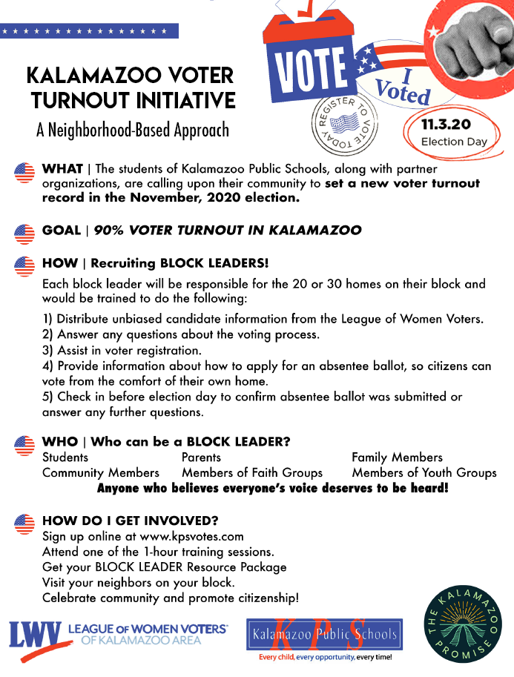
Disseminating Results: The Kalamazoo Voting Initiative!
15

Slide 16

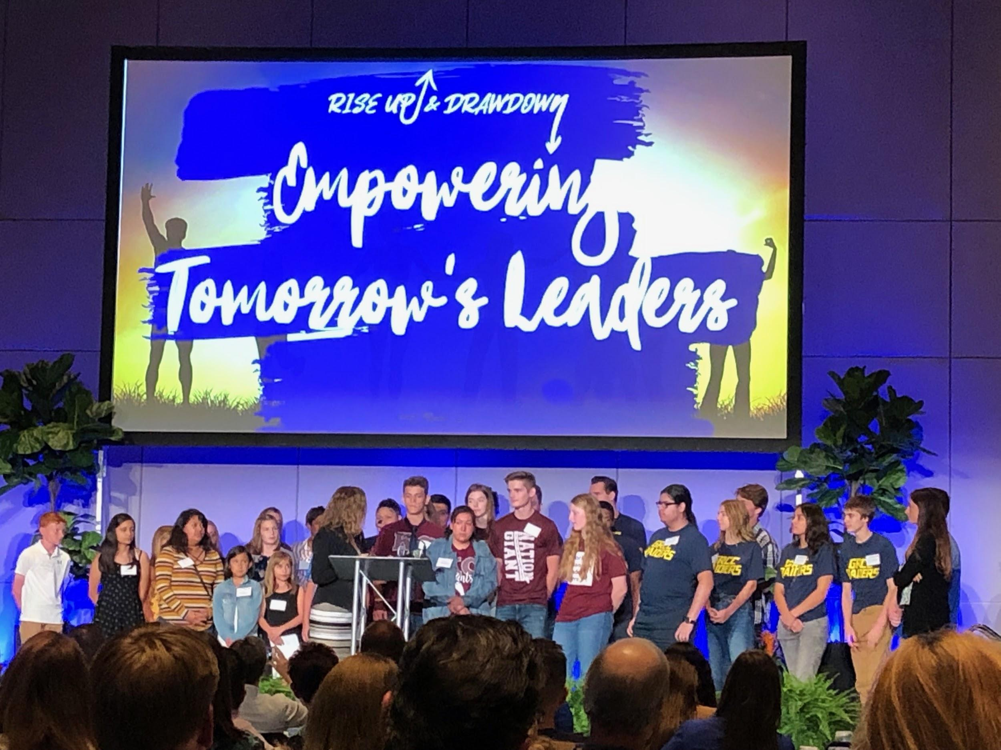
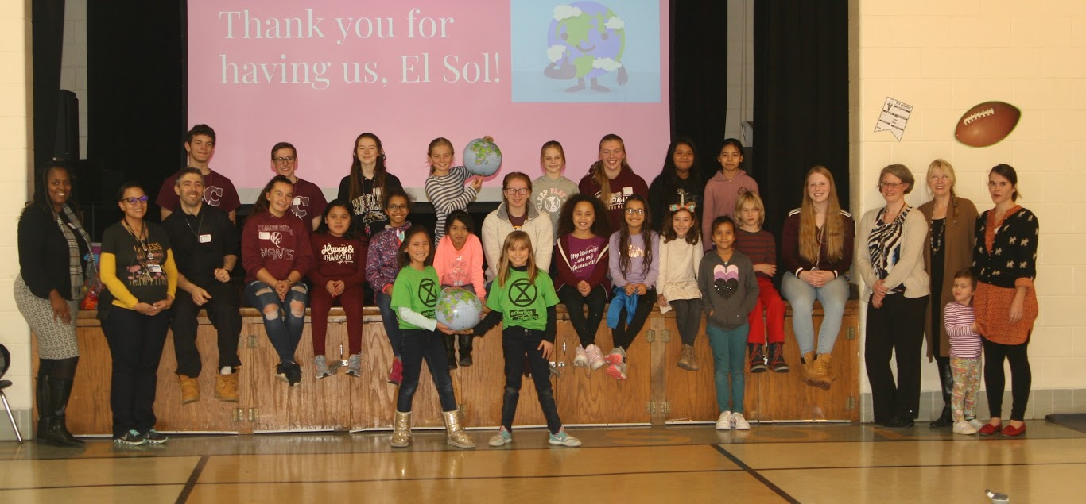

Photo Gallery
16
Notes:
16

Slide 17
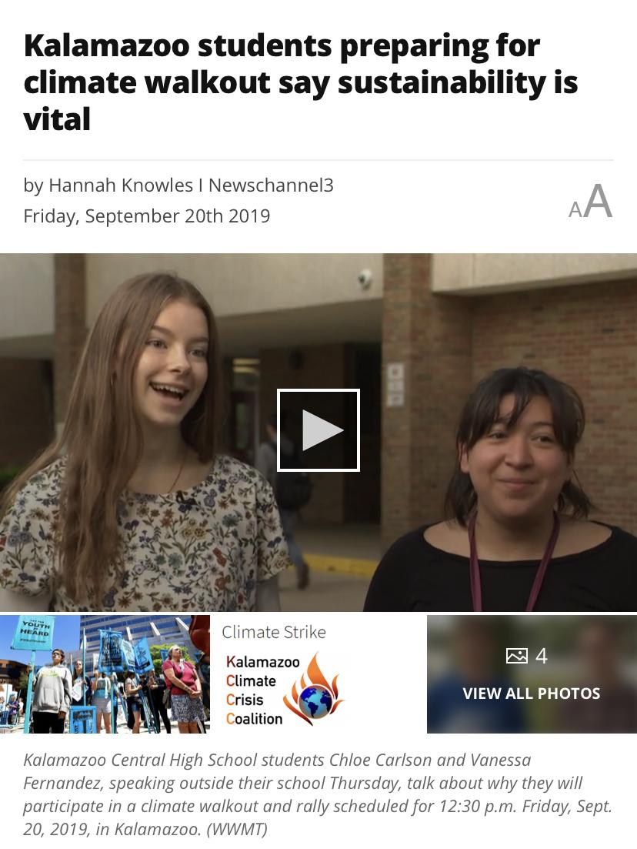
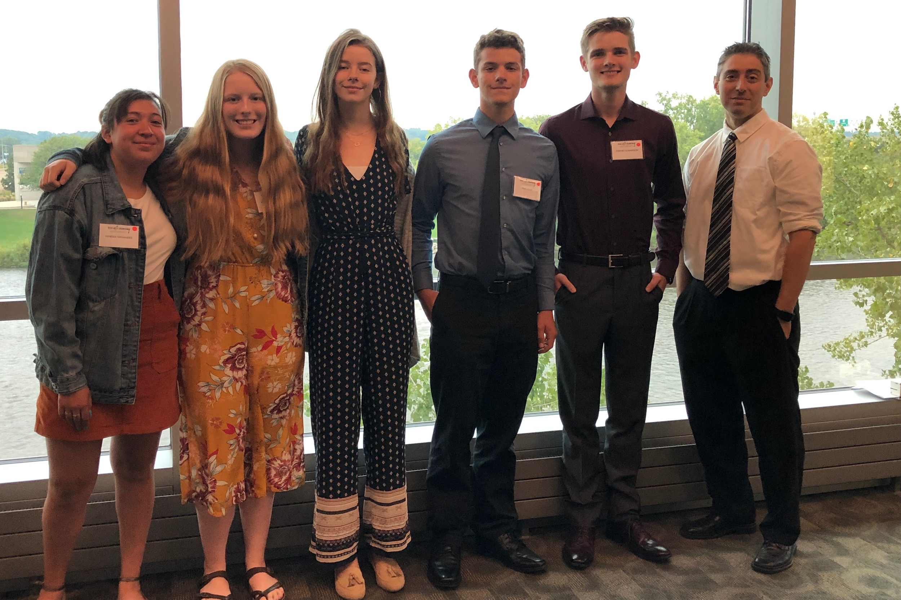

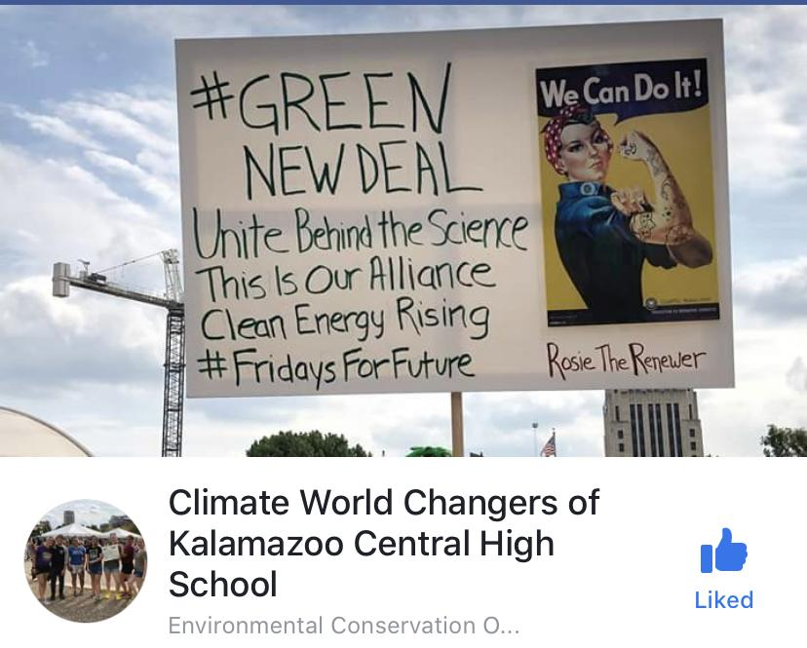
Photo Gallery (continued)
17
Notes:
17

Slide 18

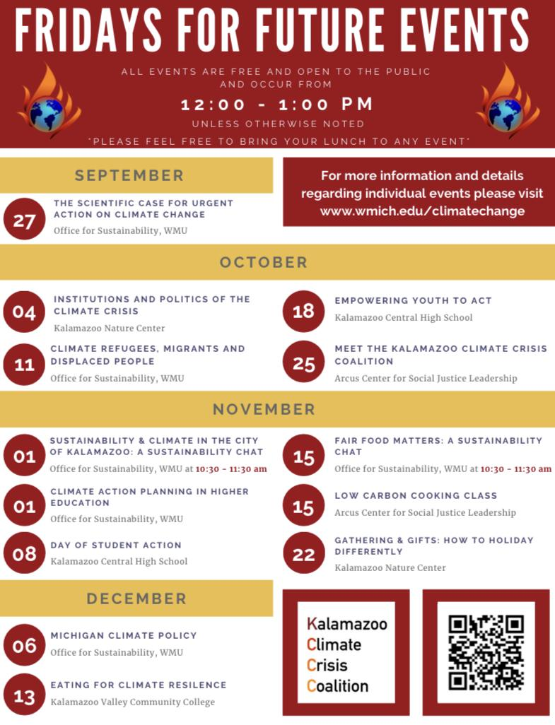
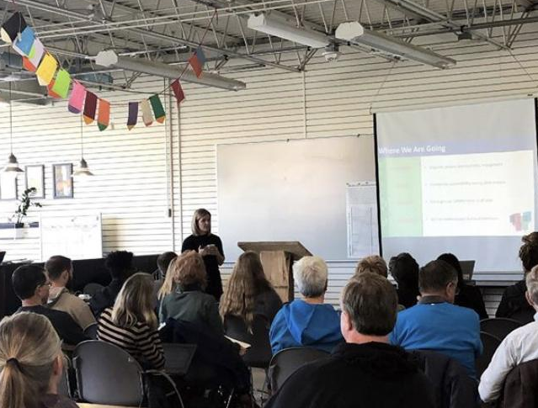
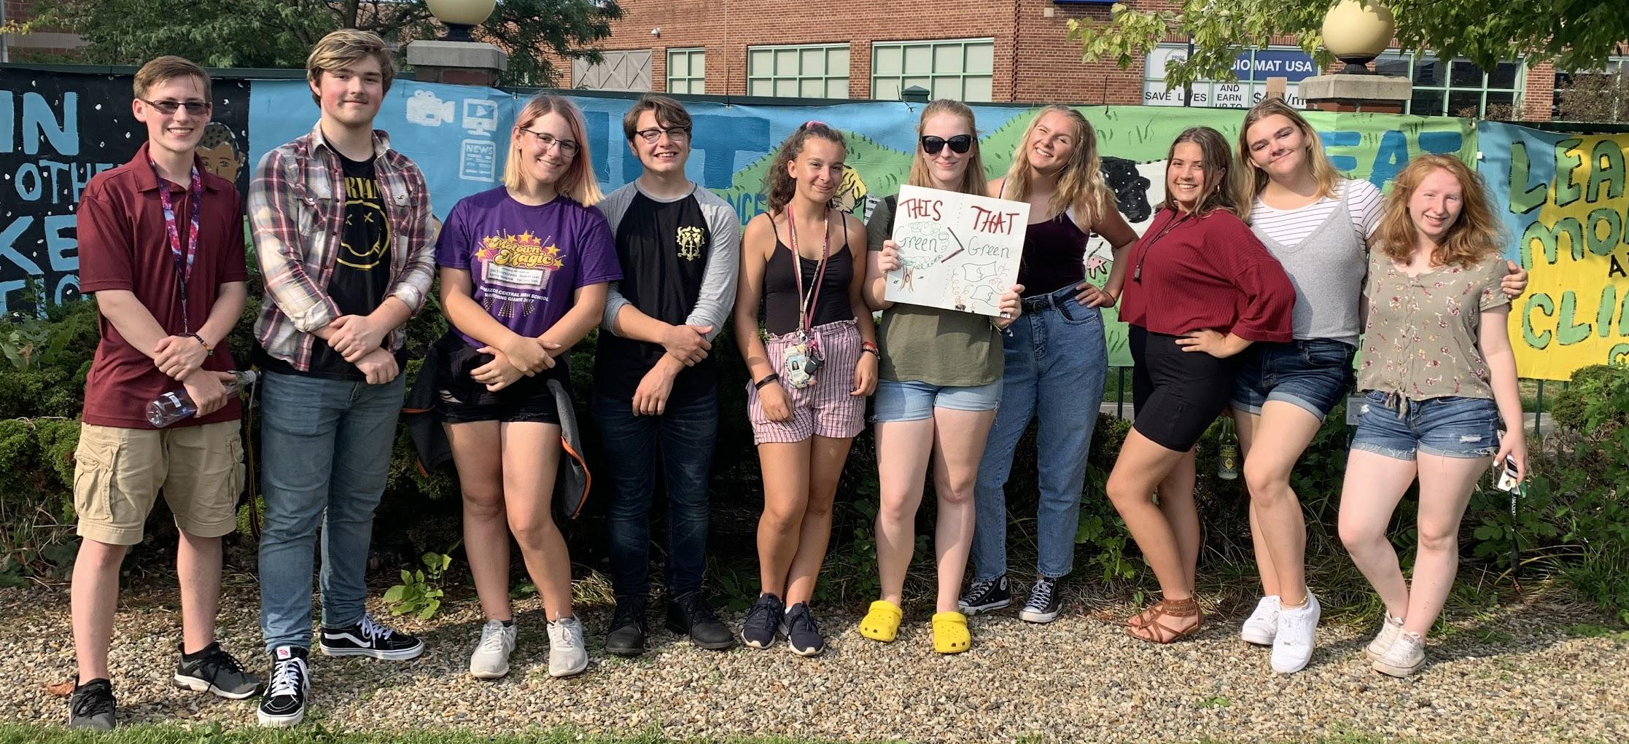
Photo Gallery (continued)
18
Notes:
18

